Slide 1
Web Based Game Development
By Nathan Hart, Harry Jackson and Samuel Tester

Slide 2
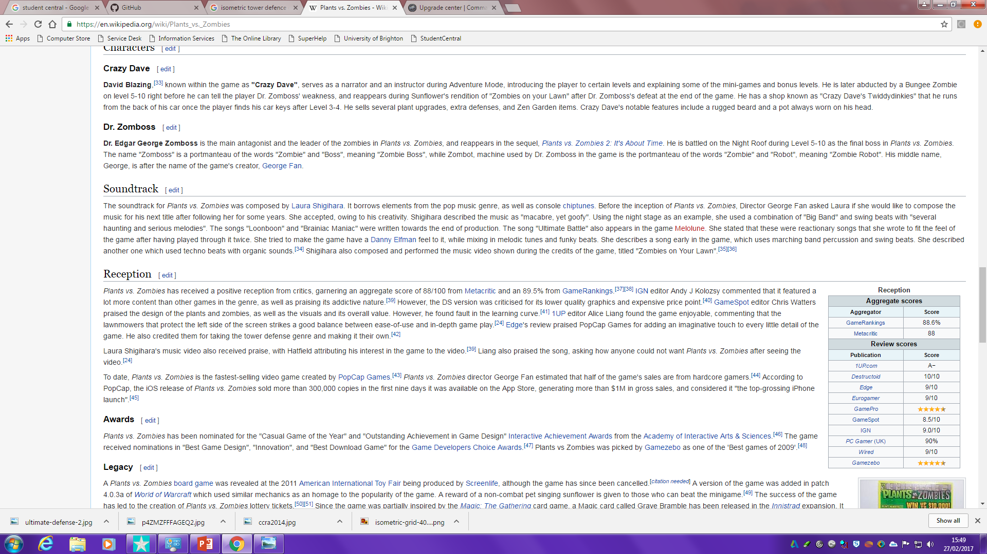
Background research
Plants VS Zombies:
At release was the most successful launch in iPhone history.
Sold 300,000 copies in the first 9 days.
The sequel got nearly 25 million downloads in the first two weeks.
At the time Plants Vs Zombies 2 was one of the first games to gross 1 million dollars in sales on the app store.
There is clearly a market for tower defence games.

Slide 3
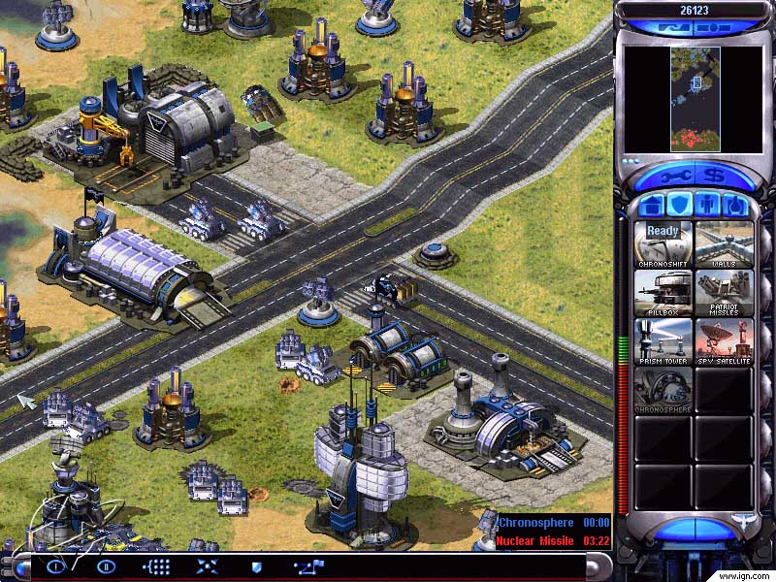
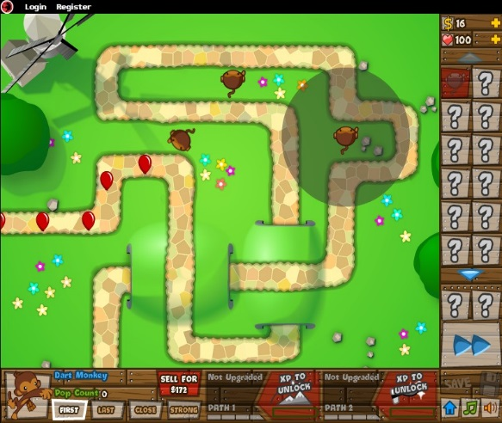
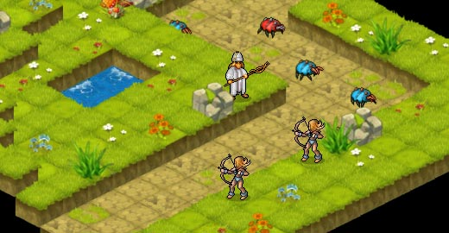
Isometric Tower Defence
Background research:
Command and Conquer - Red Alert:
Bloons Tower Defence:
Ultimate defence 2:
Notes:
Command and Conquer – Red Alert:
It is an isometric real time strategy
It offers real time upgradable units, these units include; buildings which in turn offer more powerful units as the buildings level increases.
All mobile units use pathfinding.
Bloons Tower defence:
Enemies have different weaknesses and resistances.
Enemies use pathfinding.
Enemies have different speeds and health.
Towers are used to counteract certain types of enemy weaknesses.
Towers have different costs and have different abilities.
Towers have different upgrade paths.
You can speed up time and slow it down to increase/decrease the speed that the level is completed in.
Ultimate Defence 2:
Isometric tower defence.
Tiles are labelled as accessible and non accessible to enemies.
Enemies can only move on accessible tiles.
Towers can only be placed on non accessible tiles.
Enemies use pathfinding.
- Different Types of enemies and towers.
Towers Cost money to upgrade.
Towers cost money to be placed.
Killing enemies generates money.

Slide 4
Short Brief
Our game is an isometric Tower defence game.
The games enemies will be cubes.
Cubes can be different sizes.
Cubes have different speeds, health and weaknesses and resistances.
The towers are mainly going to be triangles.
Towers will have strengths against certain cubes and be weak to others.
Will be upgradeable for a certain amount of money.
And will cost money to be placed.

Slide 5
This will be a button that will open a shop to purchase more towers to place.
Once your castle runs out of health you lose the game.
The player will able to place down towers anywhere on the grass area.
Enemy's will spawn in waves and travel to the castle so that you lose the game.
The towers will shoot bullets at the enemy's to destroy them.
Enemy's will spawn here at the start of the path and will only travel along it.
On the left hand side we will store the high score along with your current score as well as how much currency you have.
In the bottom middle we will store a count down till the next wave.

